Slide 1
Presentation on dasHboard
BY:
REG NO: 12318444
NAME: S NITIN GOURAV
ROLL NO: 39
CODE: INT589
SUBJECT: DESCRIPTIVE ANALYSIS

Slide 2

YOUTUBE dashboard
Link- https://www.kaggle.com/datasets/surajjha101/top-youtube-channels-data/data
YouTube is an American online video sharing and social media platform headquartered in San Bruno, California. It was launched on February 14, 2005, by Steve Chen, Chad Hurley, and Jawed Karim. Owned by Google, it is the second most visited website, right after Google itself. YouTube has more than one billion monthly users who collectively watch more than one billion hours of videos each day. As of May 2019, videos were being uploaded at a rate of more than 500 hours of content per minute.
YouTube has had an unprecedented social impact, influencing popular culture, internet trends, and creating multimillionaire celebrities. Despite all its growth and success, YouTube has been widely criticized. Criticism of YouTube includes the website being used to facilitate the spread of misinformation, copyright issues, routine violations of its users' privacy, enabling censorship, and endangering child safety and wellbeing.

Slide 3
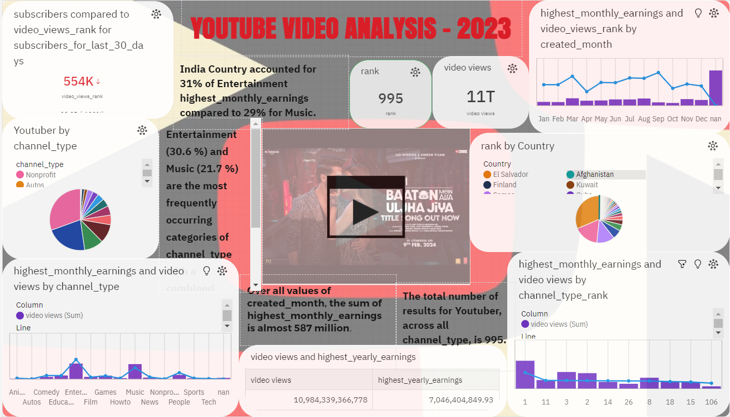
Youtube dashboard

Slide 4

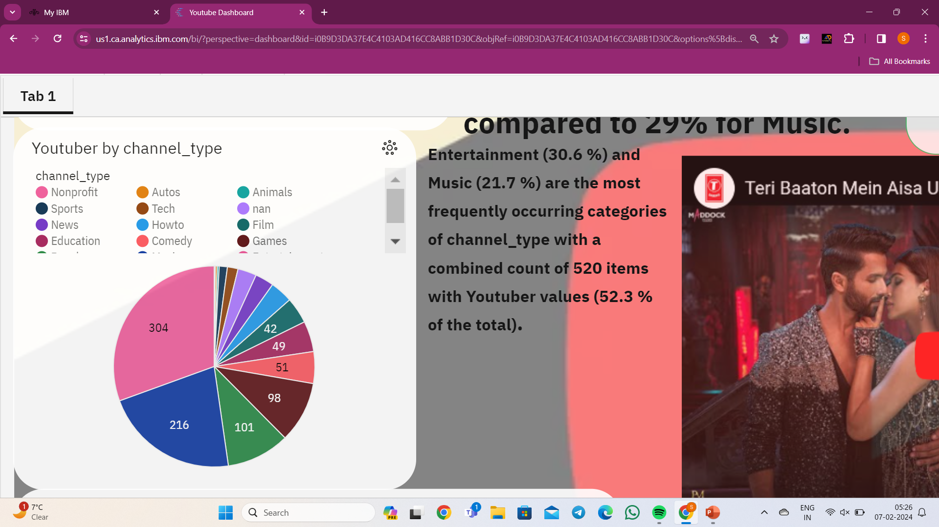
Youtube dashboard elements
1> It is created by summary and line graph which shows the subscribers to video views rank for last 30 days.
Which comes to be 22.9B subscribers, but the video views is less.
2> This is a pie chart that shows the channel type. There are several channel types. Based on these we can see entertainment and music sector has highest video views.

Slide 5
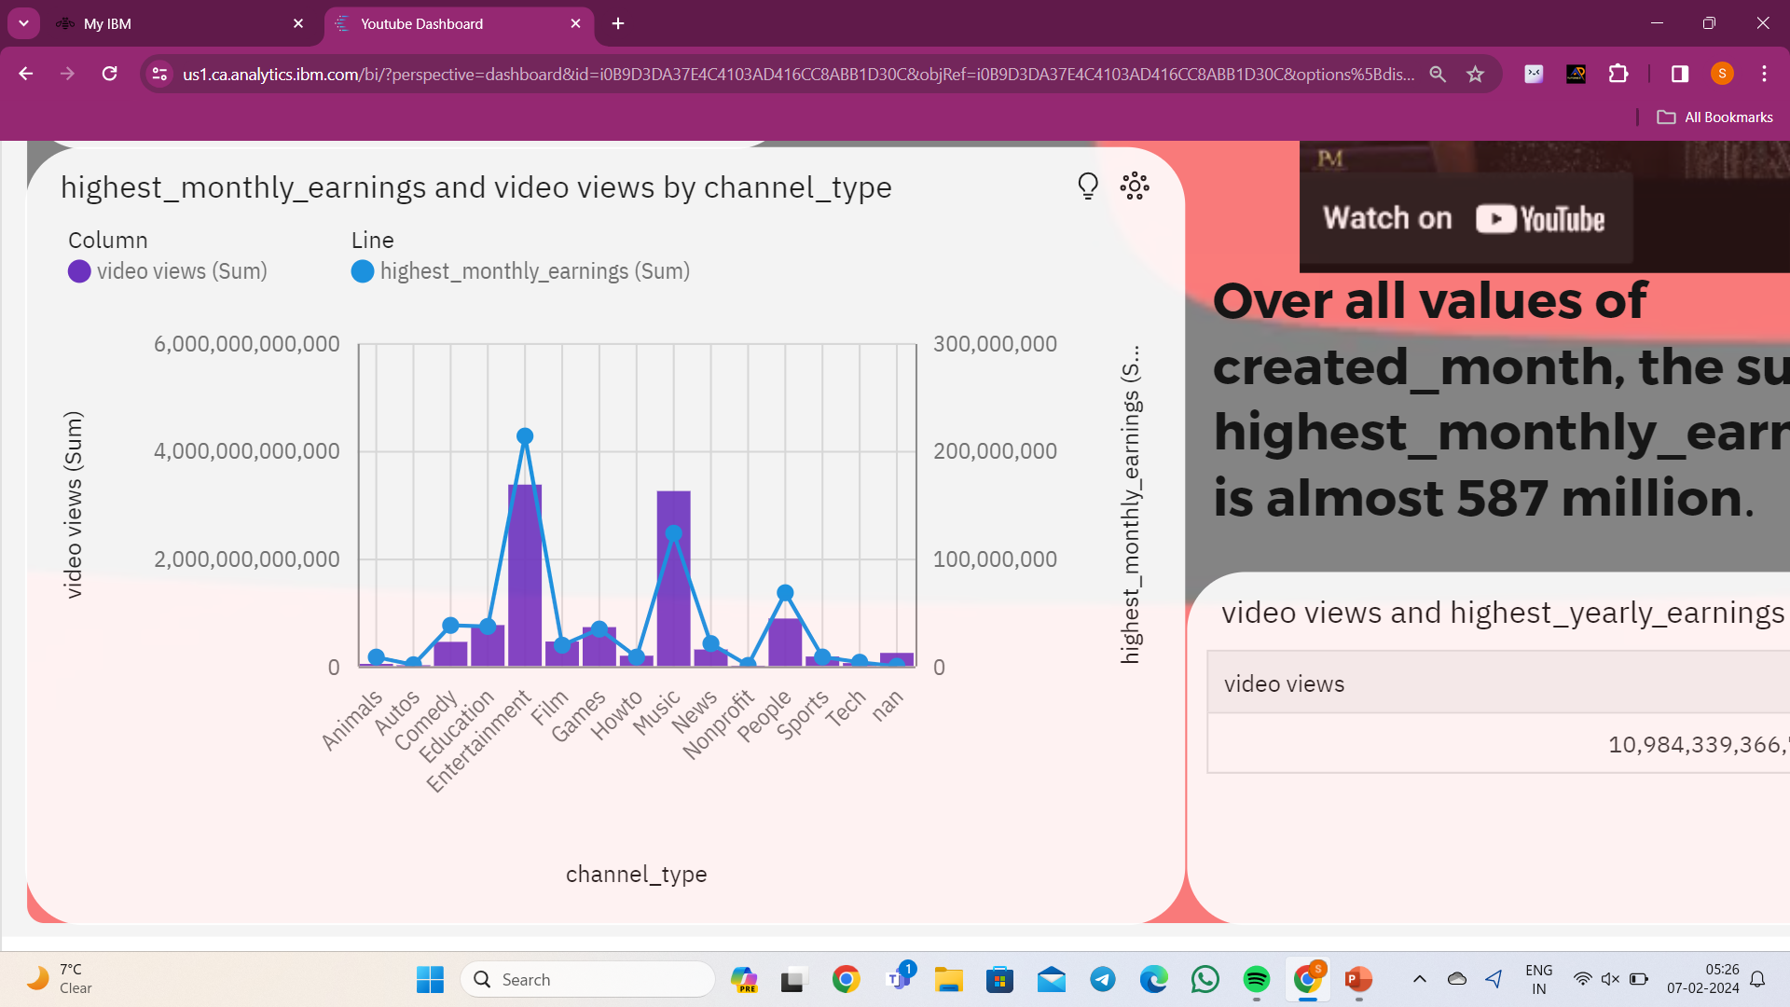
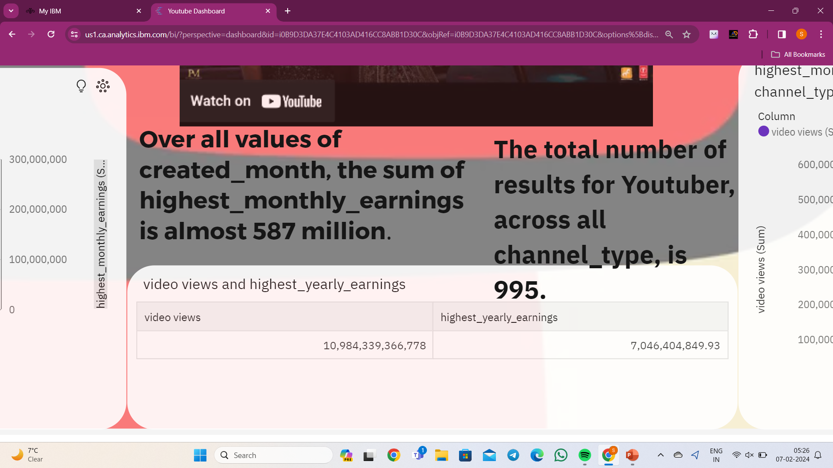
Youtube dashboard elements
3>It is a column bar graph which shows that the highest monthy earnings and views by channel type which clearly represents that the entertainment and music is highest video views and earnings as well..
4>These are text fields which are being inserted to give the insights of the youtube dashboard, so that it is easy to analyse the
Data more efficiently .

Slide 6
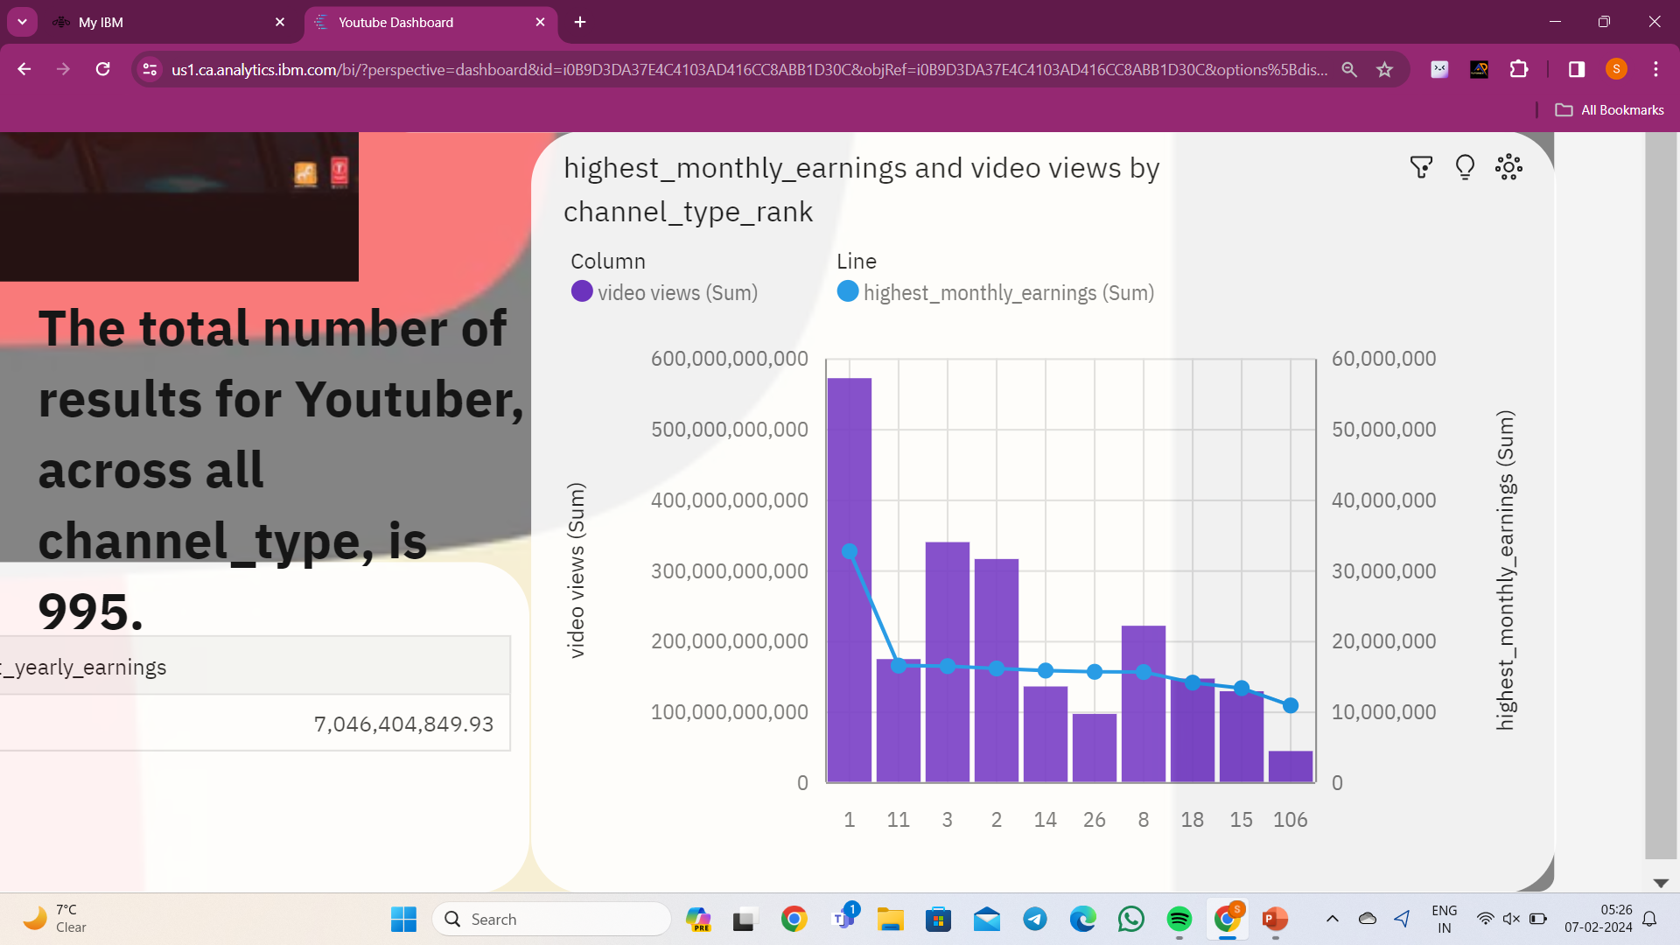

Youtube dashboard elements
5>These is the highest monthly earniings and video views by the channel type rank, which will tell us the channel ranks on basis of the rank type not on channel type of music.
6>this is a video that has been inserted into the dashboard to show that the most trending youtube music video played on the it.

Slide 7
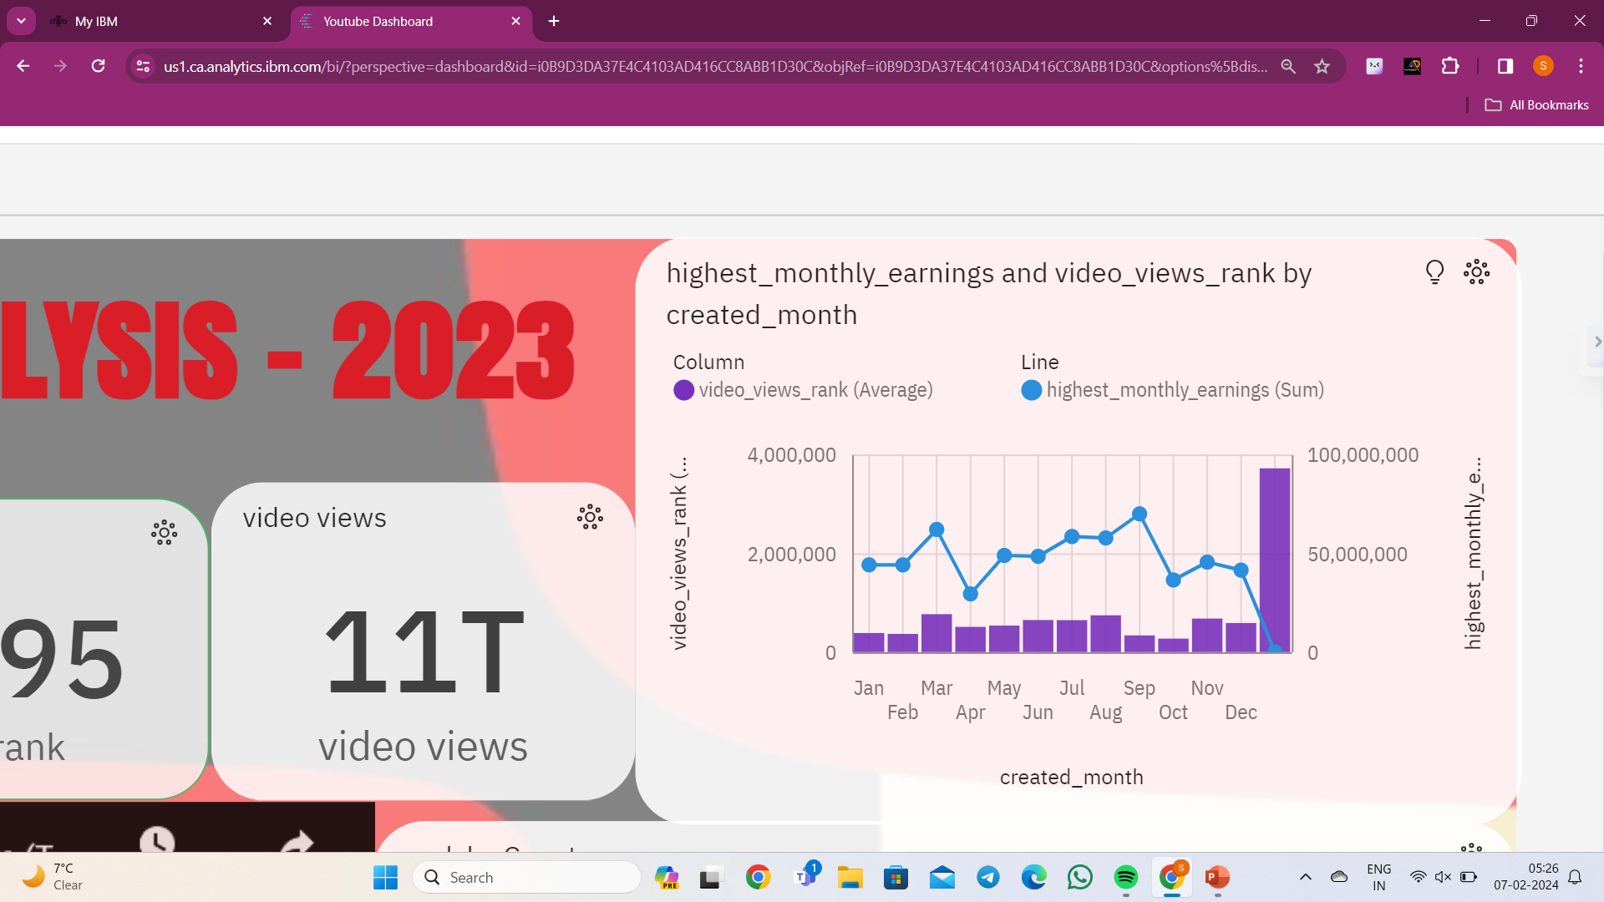
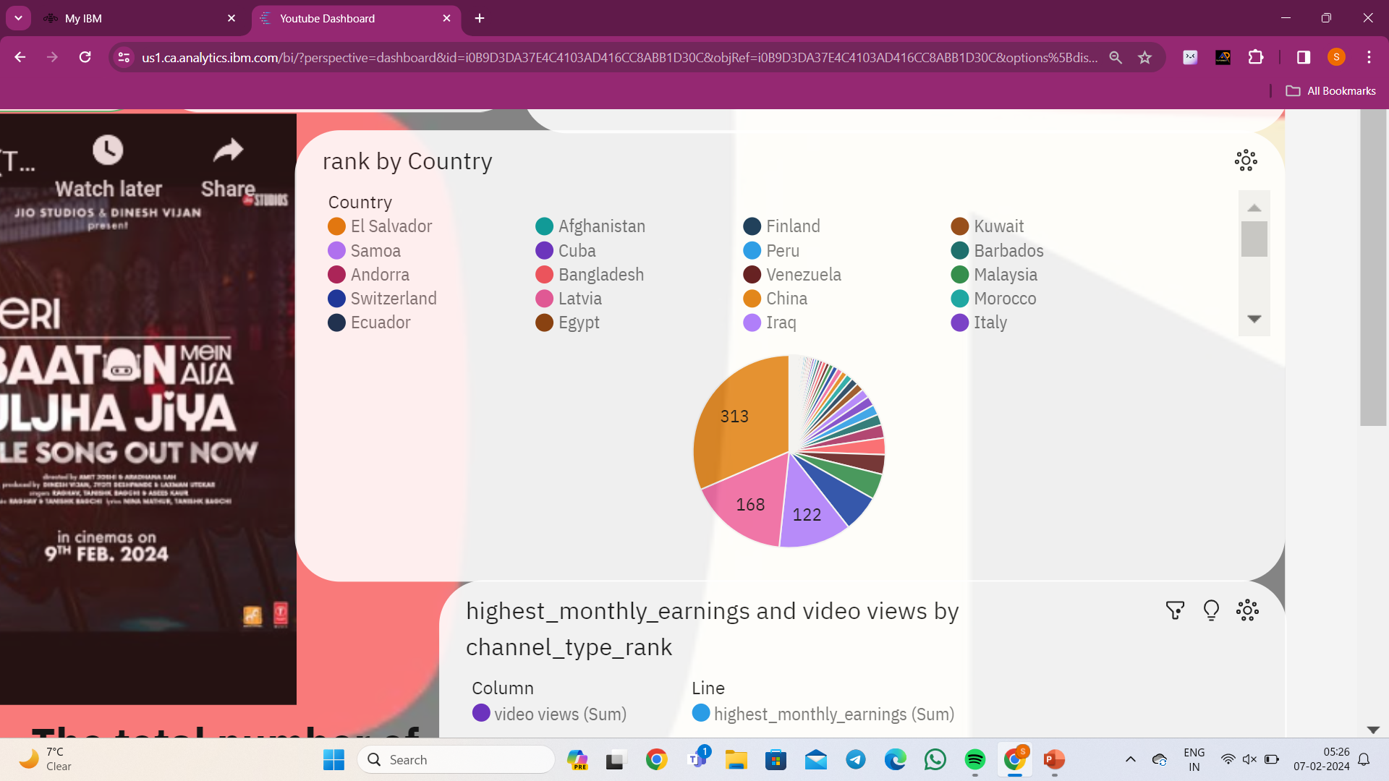
Youtube dashboard elements
7>here the summary card and as well as the highest monthly earnings and video views rank by month so that we can figure which month have highest growth.
8>it is the video views rank by country wise .

Slide 8
Youtube dashboard conclusion
Rank | Youtuber | Subscribers | Video Views | Video Count | Category | Started
1 | T-Series | 222,000,000 | 198,459,090,822 | 17,317 | Music | 2006
2 | YouTube Movies | 154,000,000 | 0 | 0 | Film & Animation | 2015
3 | Cocomelon - Nursery Rhymes | 140,000,000 | 135,481,339,848 | 786 | Education | 2006
4 | SET India | 139,000,000 | 125,764,252,686 | 91,271 | Shows | 2006
5 | Music | 116,000,000 | 0 | 0 | 2013
6 | PewDiePie | 111,000,000 | 28,469,458,228 | 4,497 | Gaming | 2010
7 | MrBeast | 102,000,000 | 16,832,456,681 | 726 | Entertainment | 2012
Top Channels by Subscribers:
T-Series is the leading channel with 222
million subscribers.
YouTube Movies and Cocomelon – Nursery
Rhymes follow with 154 million and
140 million subscribers, respectively.
Video Views and Uploads:
Cocomelon - Nursery Rhymes has an
impressive 135 billion video views, making
it one of the most-watched channels.
PewDiePie has a substantial number of
video uploads (4,497), contributing to his
overall video views of 28 billion.
Categories of Top Channels:
Music channels, such as T-Series, YouTube
Movies, and Cocomelon, dominate the
top positions.
Entertainment and People & Blogs categories
also have a significant presence in the
top channels.

Slide 9
THANK YOU

